Slide 1
Female experience in driving skills training
Sultan (Presentation Lead)
Saqr (Research Lead) Khalid (Research Lead) Afnan (Design Lead) Nada (Product Manager)

Slide 2
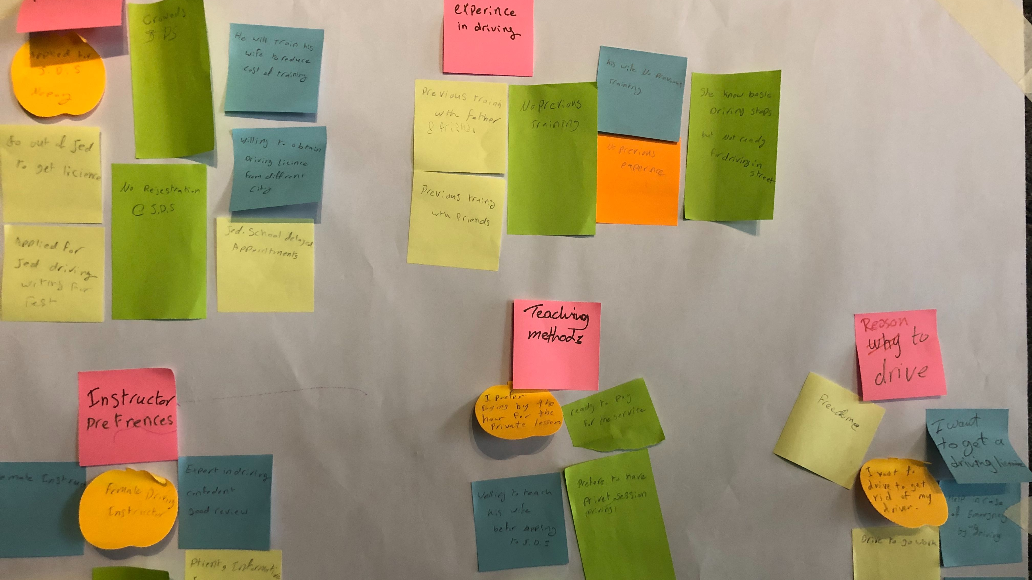
SUMMARY OF OUR USER RESEARCH FINDINGS

Slide 3
summary of our user research findings
Who our audience are
Our user’s needs
An alternative way of getting driving skills training.
Affordable price.
Flexible time.
Why?
Save expenses.
Freedom of movement and full independency.

Slide 4
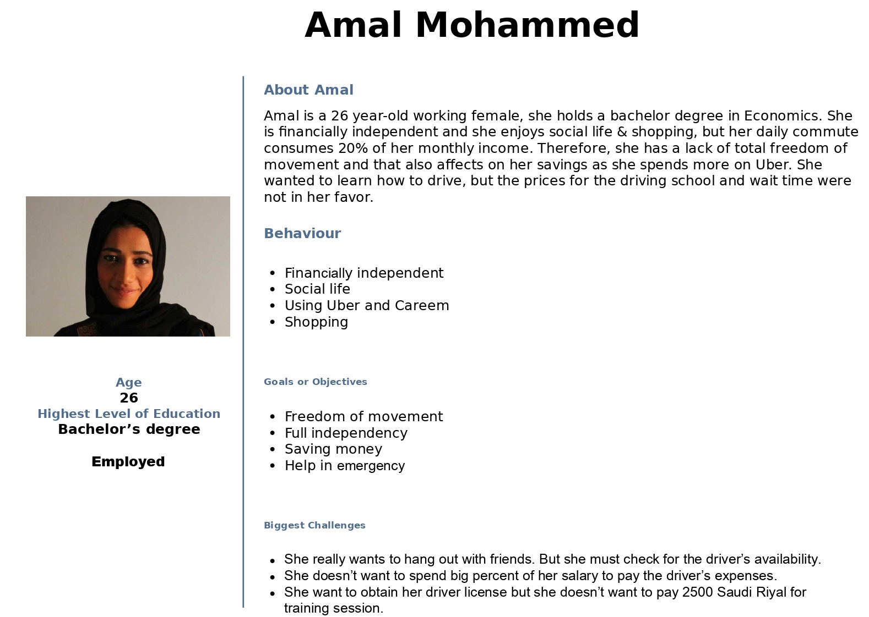
Our persona

Slide 5
Hypothesis & solution

Slide 6

summary of our user research findings
Solution
Provide an on-site private 1 to 1 driving training service based on the user's availability.
What we will accomplish?
Achieve having more qualified and confident female drivers.
An alternative way of getting excellent training for an affordable price.

Slide 7
Competitive analysis
U Drive vs …. ?

Slide 8
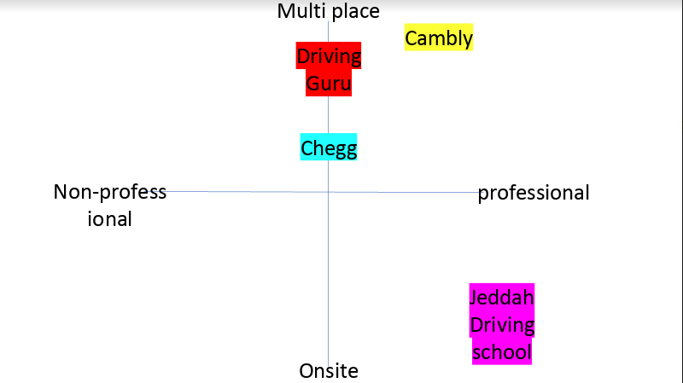
Who are our competitors?
Traditional Driving School
Other similar services:
My Drive Guru (USA)
Chegg
Kambily

Slide 9

U DRIVE VS WHO?
We are pioneers in offering such a service in the kingdom
Our only competitor is the traditional driving school
Even internationally, there’s only one similar service in the US (My Drive Guru)
People trust the traditional school because there’s no alternative.
We are cooperating with the Traffic Police & licensed by MOI

Slide 10


U DRIVE VS DRIVING SCHOOL
Driving School
U Drive
VERY expensive
No time flexibility
Long wait times (ugh)
Repeat same process if failed the test
Affordable prices
Flexible time & date
Start immediately after signing up
We will make sure you pass ;)

Slide 11
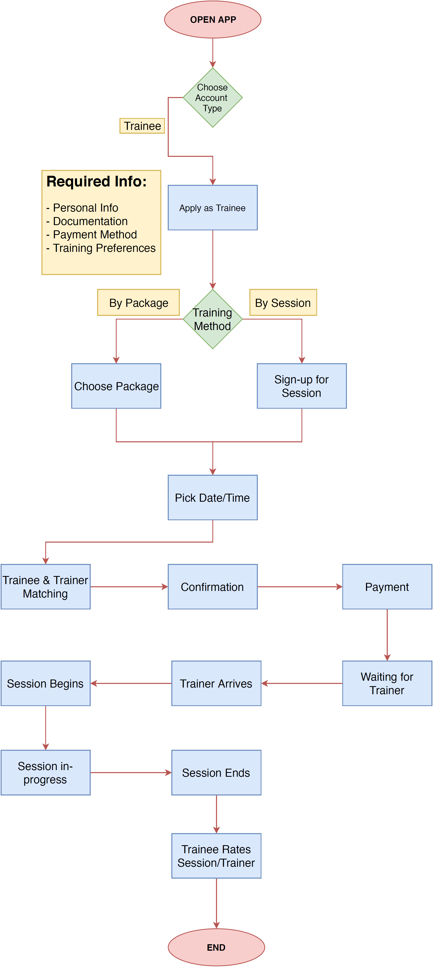
Our user flow

Slide 12
Users feedback
- First diamond is wrong
- You have only one way so diamond isn't the best choice
- Why diamond?? (Choose Account Type)
- Well done but it's better if show the path for trainer
- Sign-up for Package
- I think pick date/time will different according to training method
- The waiting and arriving of the trainer don't happen within the website so don't include!
- Training location is important
- Do I have the choice to pick my car or the trainers car?
- Not clear in which screen I'am according to navigate
- Very Complicated

Slide 13
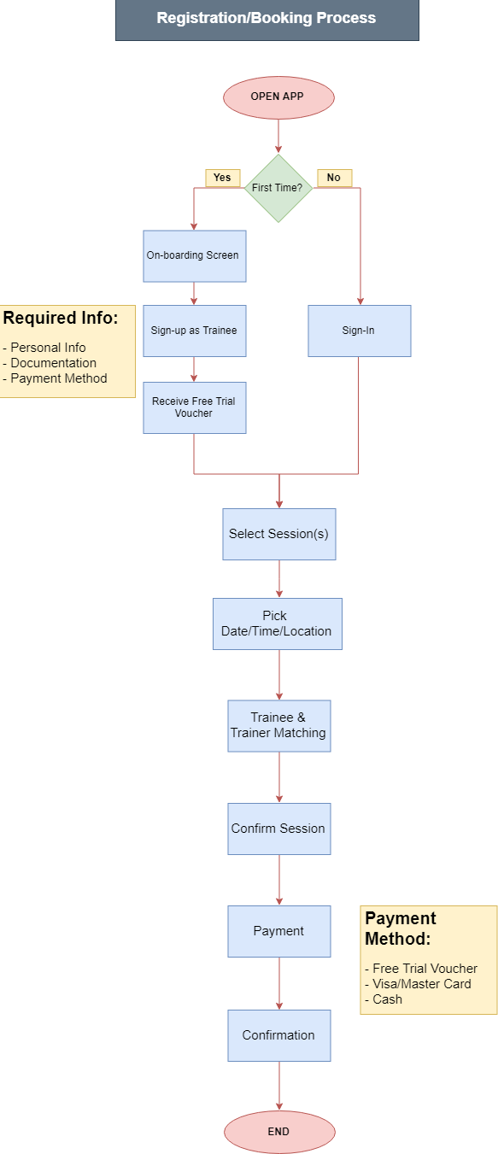
Our user flow

Slide 14
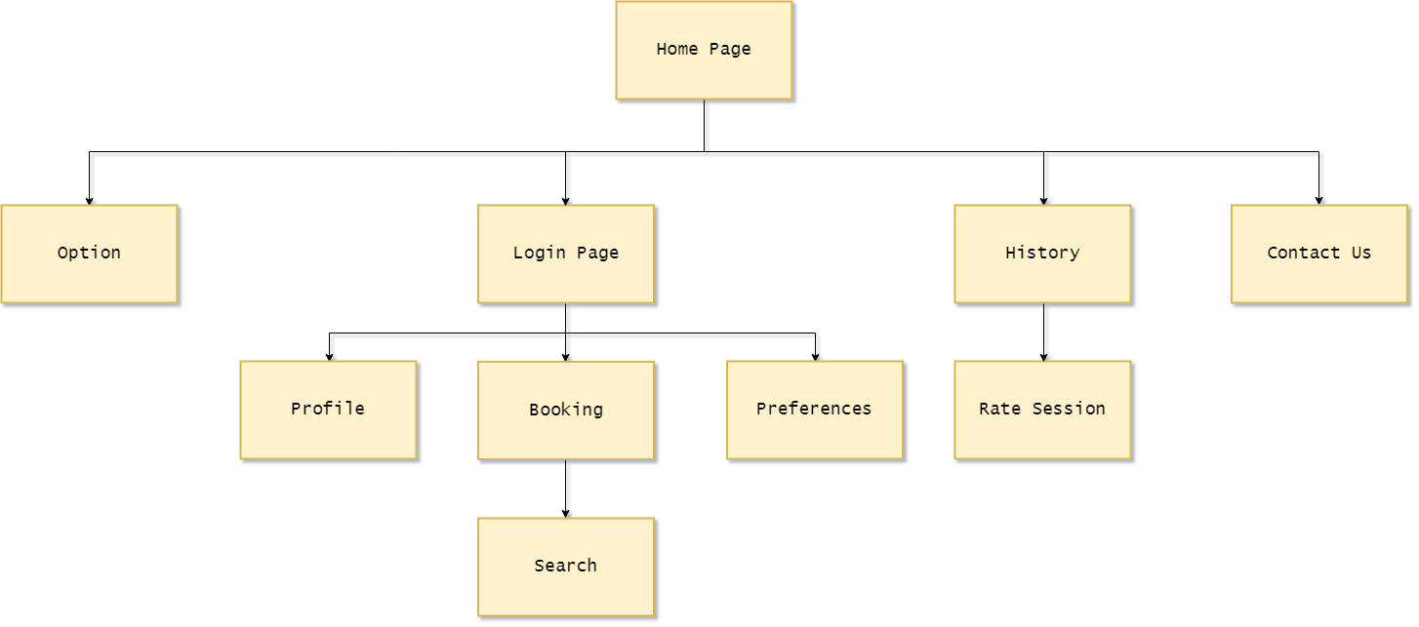
Card sort findings
Before

Slide 15
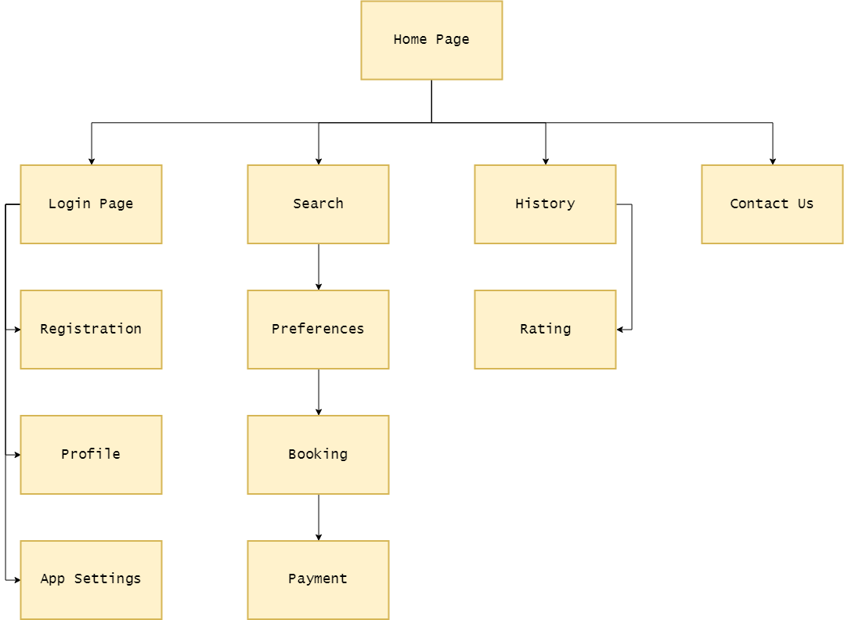
Card sort findings
After

Slide 16
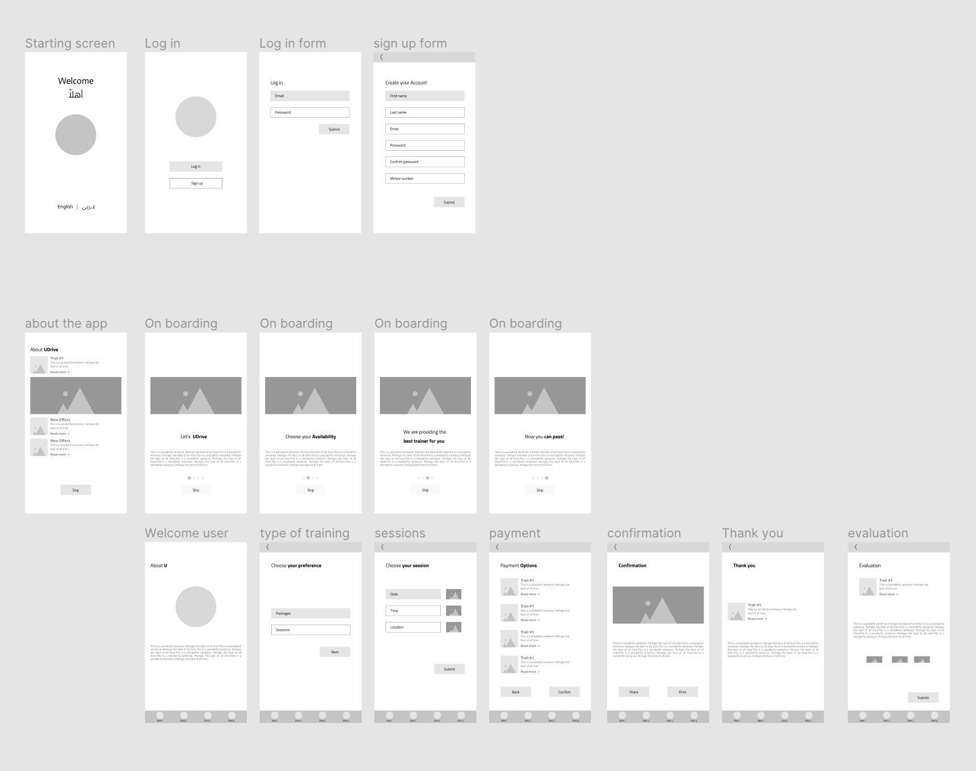
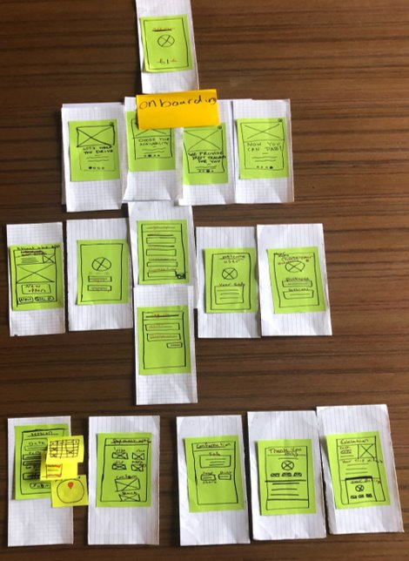
Wireframes

Slide 17
Wireframe and Usability test
Welcome page was confusing
Navigator missing
Date & Time should be combined
Confirmation page missing send
Add criteria to evaluation page
Confirmation/cancelation before payment

Slide 18
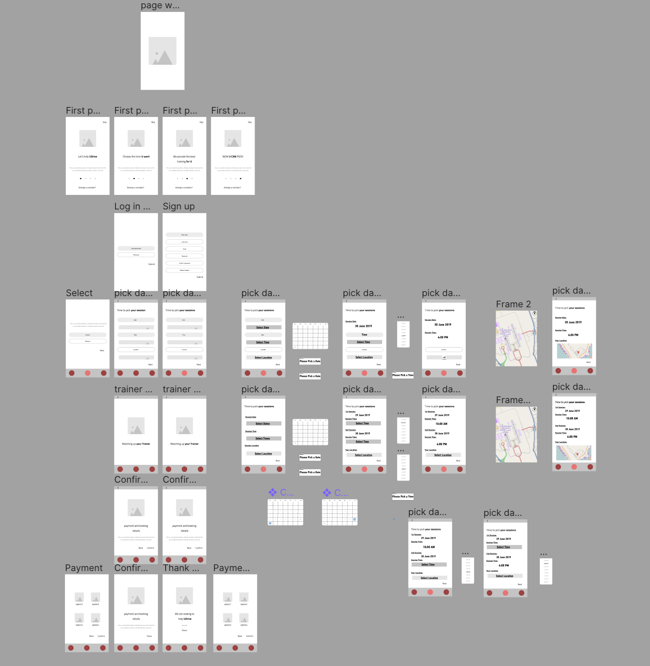
After the first usability test

Slide 19
Visuals

Slide 20
Visuals

Slide 21
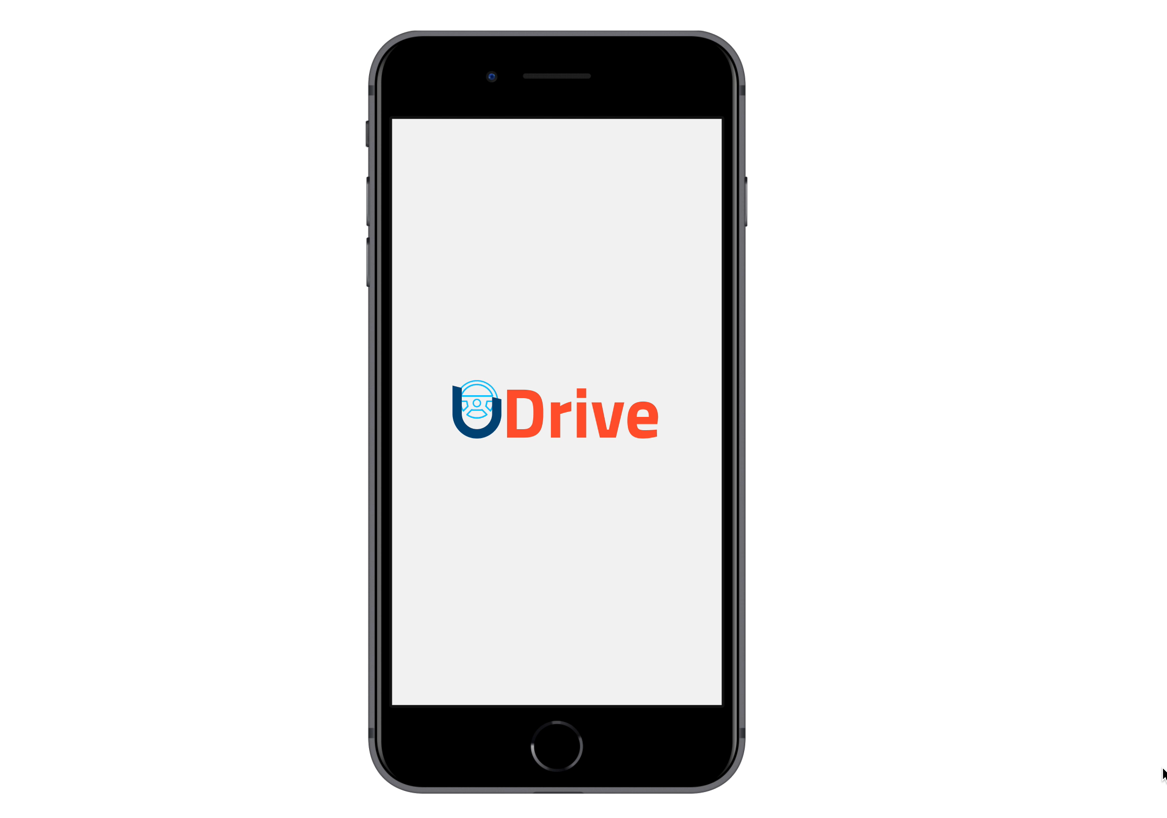
LET'S TRY IT out
https://www.figma.com/proto/QPUPxyheEkcDoxykJadthh/digital-Udrive?node-id=1%3A38&viewport=-1287%2C479%2C1&scaling=scale-down

Slide 22
USABILITY TEST
Usage
The colors
Layout

Slide 23
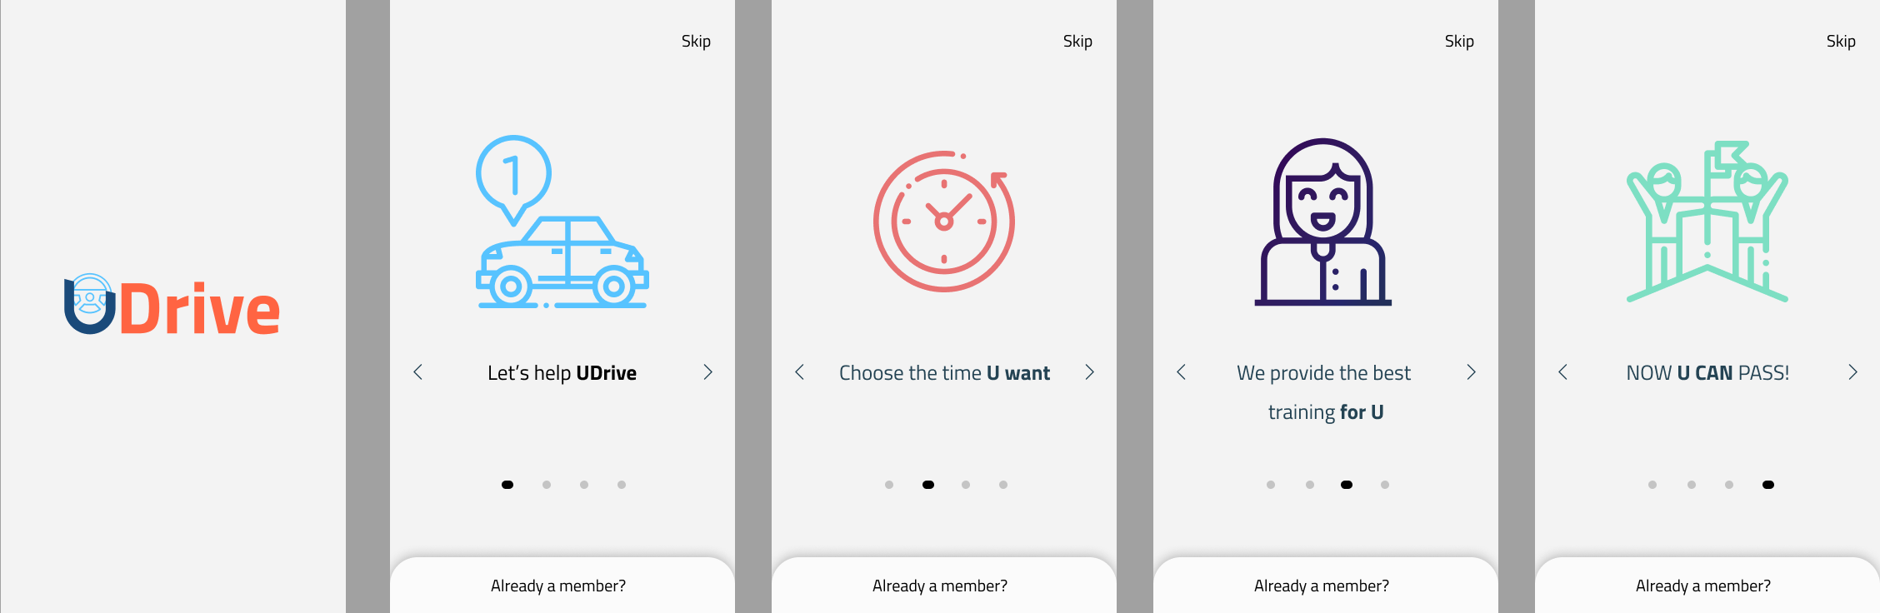
Welcome screen and onboarding

Slide 24
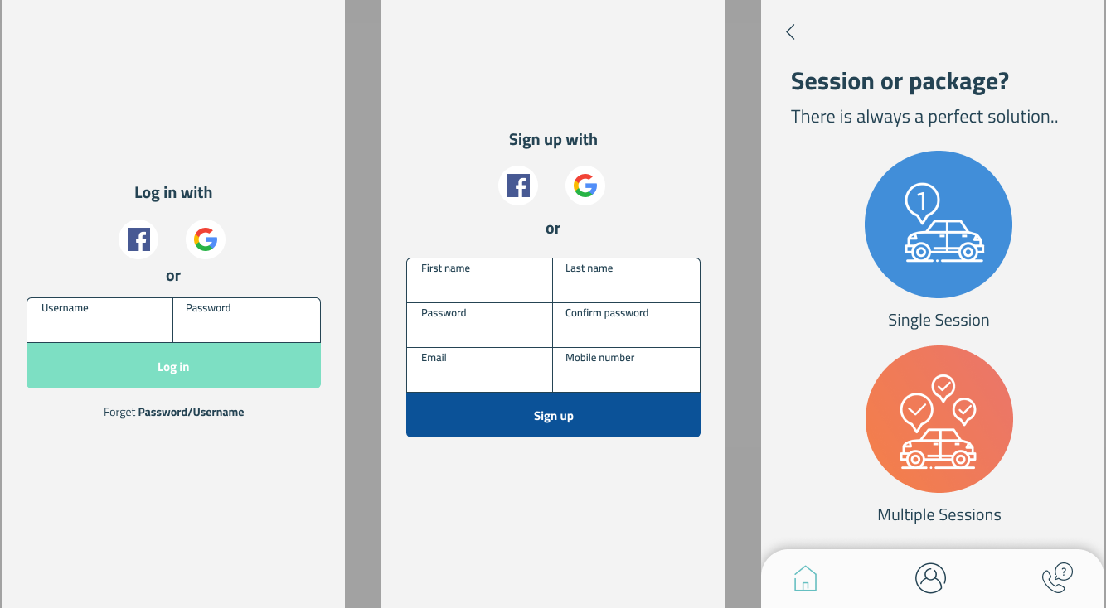
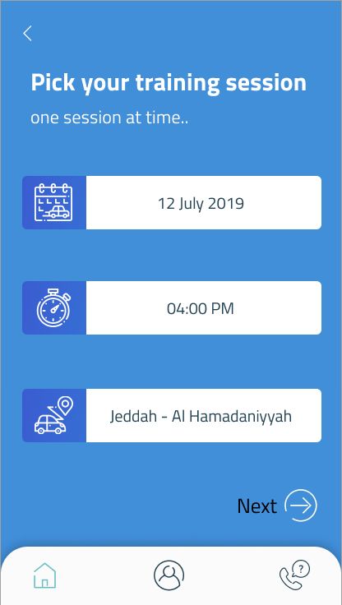

Slide 25
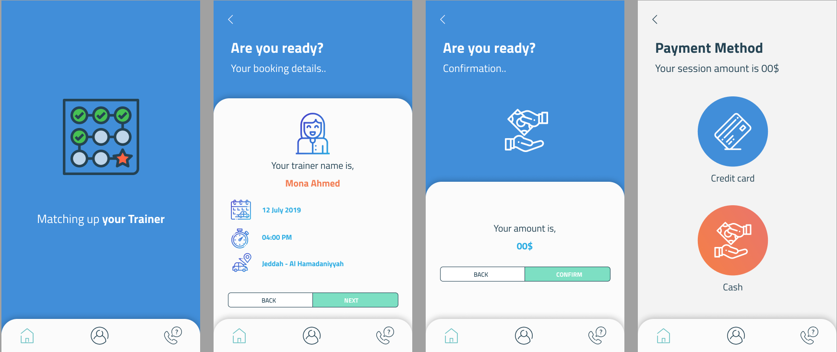
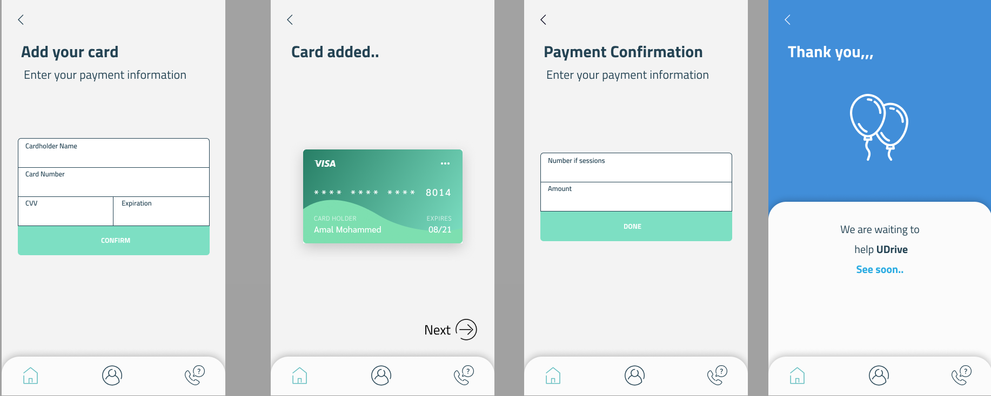

Slide 26
Conclusion

Slide 27
How our differs from existing product
Safe driving training:
We are the only authorized agency for female driving training
Fixable time
Our service is based on the user availability (fixable date & time)
Affordable price:
Sessions and payment options

Slide 28

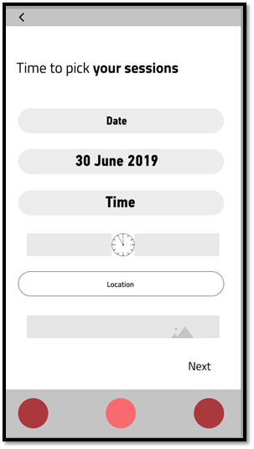
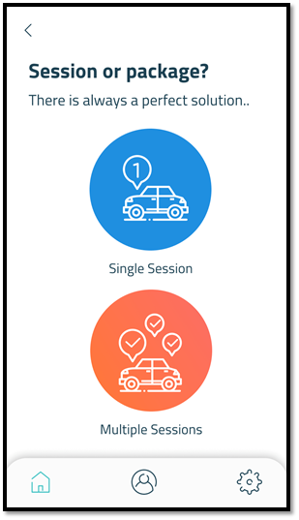
How research finding informed design decision
Lack of time flexibility
Ride sharing apps
Paying for chauffeurs
Certain training times
Certain training times
Registration fee

Slide 29
differences between initial assumption & final product

Slide 30
Differences
1. Trainer

Slide 31

Trainer Persona
Finding from interviews:
long experience,
patient,
Age over 30,
Male
Female

Slide 32
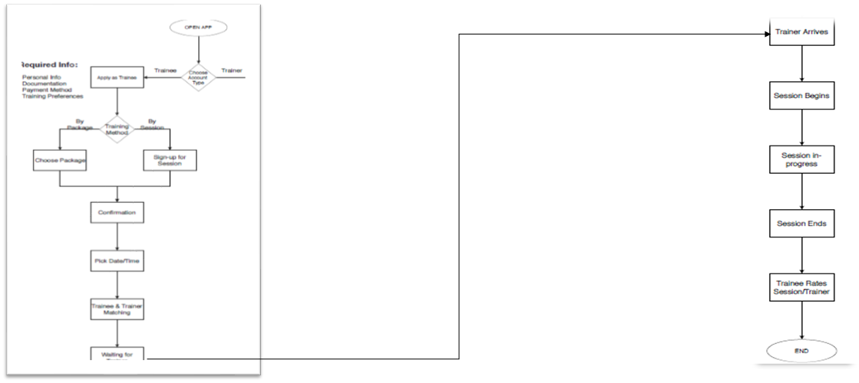
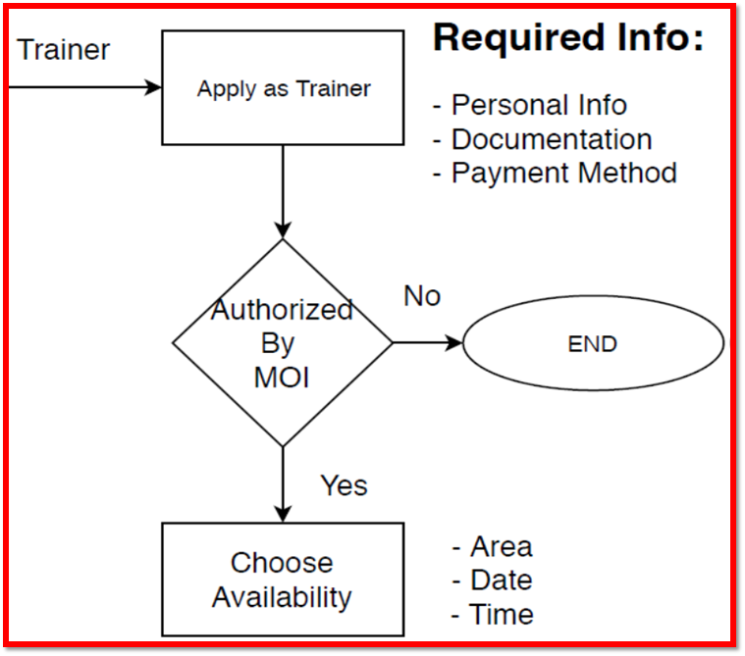
Trainer Flowshrt

Slide 33
Differences
2. Packages

Slide 34
Finding from interview
•Willing to pay per package
•There were concerns about the price of the packages,
•How if they want to cancel

Slide 35
Packages flowchart

Slide 36
Similarities between initial assumption & final product

Slide 37
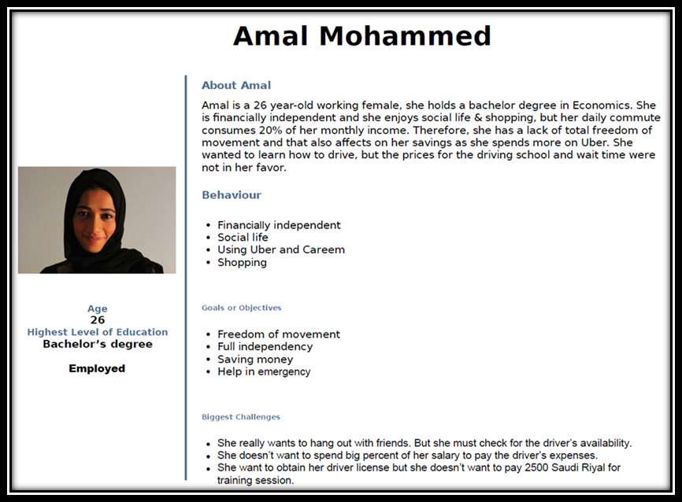
Similarities
We Love you AMAL
Trainee
(Persona)

Slide 38
MVP Minimum Viable Product

Slide 39
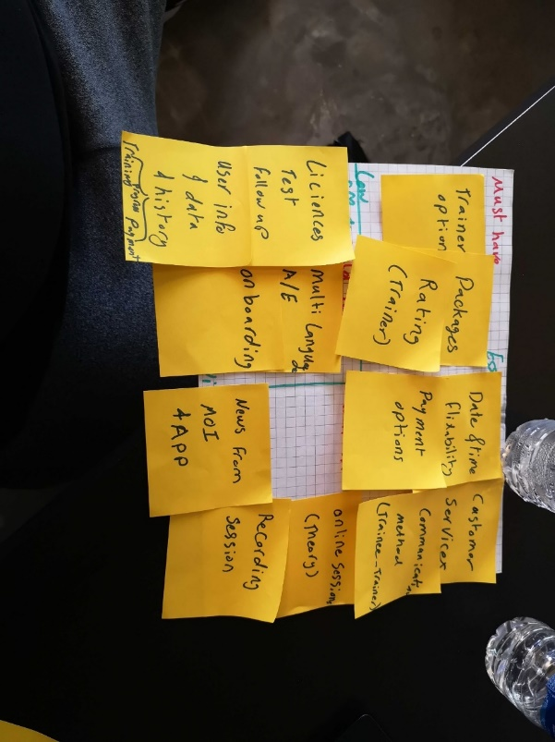
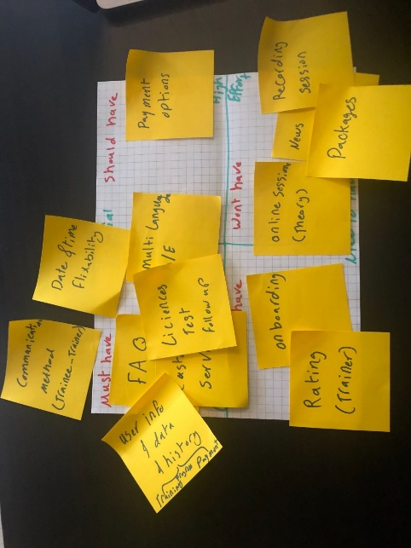
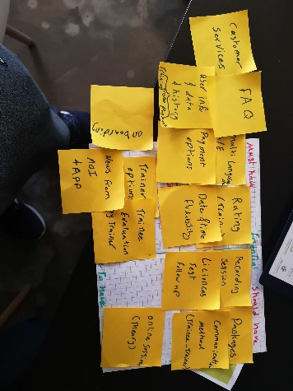
MVP
Features set by user #2
Features set by designers (team)
The essential- low effort chart was entirely different from ours. It’s interesting to look up what matters to the user the most.
Features set by user #1

Slide 40
Motivation for our user to return
Since the relation between the trainee and the App will finish by the trainee receiving her driving license, we count on the good service we provide and the recommendation from the trainees.

Slide 41

Future plan
Add packages
Add trainer selection options

